Slide 1





A smart grid of plastics – Technical conditions for the sorting and pre-step evaluation for a “factory of the future”
Project progress
Anamaria Barrera Bogoya
Tutors:
Hakim Boudaoud
Fabio A. Cruz S.
Cécile Nouvel
Sina Leipold
03/04/2019

Slide 2

Content
Project context
Objectives
3D Printing Open-source
Additive Manufacturing
Plastics in 3D printing
Plastic recycling Pre-step
Methods of plastic recycling
Mechanical recycling steps in centralized circuit
Circular Economy
Circular Economy Vision
Context: Statistics of wastes management
Planning
Next steps
References

Slide 3

Project context
Geographical distributed space where the polymer recycling process of the surrounding areas will be carried out.
Objective: Plastic recycling by 3D Printing in short circuit.
Development of a circular economy circuit with the feedstock of 3D Printers.
Benefits:
Avoid the use of the environment as a sink for residuals
Minimize the use of virgin materials

Slide 4
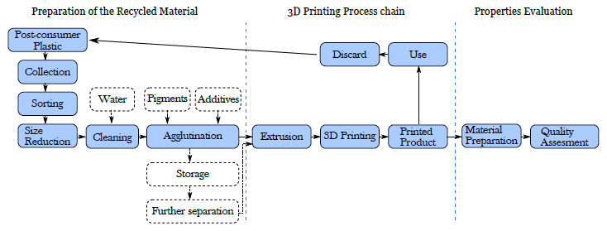
Project context
Pavlo, S., Fabio, C., Hakim, B., & Mauricio, C. (2018). 3D-Printing Based Distributed Plastic Recycling: A Conceptual Model for Closed-Loop Supply Chain Design. In 2018 IEEE International Conference on Engineering, Technology and Innovation (ICE/ITMC) (pp. 1–8). IEEE.
Cruz Sanchez, F. A., Boudaoud, H., Hoppe, S., & Camargo, M. (2017). Polymer recycling in an open-source additive manufacturing context: Mechanical issues. Additive Manufacturing, 17, 87–105.
Anamaria

Slide 5
Objectives
How to generate a local circuit of plastic recycling for 3D Printing in Nancy?
3D Printing Open-source
Circular Economy – Local Circuit
Plastic Recycling Pre-step
Anamaria

Slide 6
OBJECTIVES
1. 3D Printing Open – Source | 2. Plastic Recycling Pre - step | 3. Circular Economy – Local Circuit
Bibliographic research: 1.1. Additive manufacturing 1.2. Plastics used in 3D Printing | Bibliographic research: 2.1. Scientific: Methods of plastic recycling 2.2. Technique: Mechanical recycling steps in centralized circuit | Bibliographic research: 3.1. Circular Economy vision 3.2. Context: Deposit of plastic wastes in Europe, France and Nancy 3.3. How to make a local circuit emerge? Business sector Public sector Citizen sector 3.4. Indicators and tools for economical, environmental and social evaluation.

Slide 7
OBJECTIVES
1. 3D Printing Open – Source | 2. Plastic Recycling Pre - step | 3. Circular Economy – Local Circuit
Bibliographic research: 1.1. Additive manufacturing 1.2. Plastics used in 3D Printing | Bibliographic research: 2.1. Scientific: Methods of plastic recycling 2.2. Technique: Mechanical recycling steps in centralized circuit | Bibliographic research: 3.1. Circular Economy vision 3.2. Context: Deposit of plastic wastes in Europe, France and Nancy 3.3. How to make a local circuit emerge? Business sector Public sector Citizen sector 3.4. Indicators and tools for economical, environmental and social evaluation.

Slide 8
1.1. Additive manufacturing
Additive Manufacturing
Material Jetting
Binder Jetting
Material Extrusion
Powder Bed Fusion
Directed Energy Disposition
Sheet Lamination
Vat Photopolymerization
Open – source technologies
Figure 1. Additive Manufacturing classification. Adapted from [1 – 2]

Slide 9
1.1. Additive manufacturing
Additive Manufacturing
Material Jetting
Binder Jetting
Material Extrusion
Powder Bed Fusion
Directed Energy Disposition
Sheet Lamination
Vat Photopolymerization
Technologies made for metals. High energy consumption
Figure 1. Additive Manufacturing classification. Adapted from [1 – 2]

Slide 10
1.1. Additive manufacturing
Additive Manufacturing
Material Jetting
Binder Jetting
Material Extrusion
Powder Bed Fusion
Directed Energy Disposition
Sheet Lamination
Vat Photopolymerization
Technology that works with thermosets. Recycling process is not possible.
Figure 1. Additive Manufacturing classification. Adapted from [1 – 2]

Slide 11
1.1. Additive manufacturing
Additive Manufacturing
Material Jetting
Binder Jetting
Material Extrusion
Powder Bed Fusion
Directed Energy Disposition
Sheet Lamination
Vat Photopolymerization
Technologies that require use of glue. There is no interest for recycling process.
Figure 1. Additive Manufacturing classification. Adapted from [1 – 2]

Slide 12
1.1. Additive manufacturing
Additive Manufacturing
Material Jetting
Binder Jetting
Material Extrusion
Powder Bed Fusion
Directed Energy Disposition
Sheet Lamination
Vat Photopolymerization
Figure 1. Additive Manufacturing classification. Adapted from [1 – 2]

Slide 13
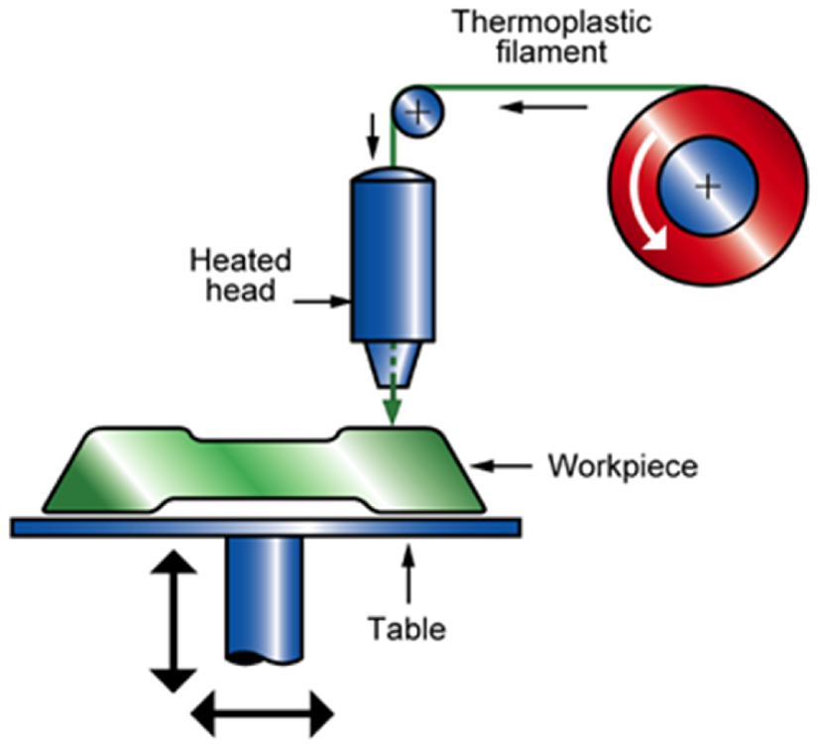
1.1. Additive manufacturing
Fused Deposition Modelling What is IT ?
- It is the most common method of 3D Printing. (500 000 desktop units sold)
- This process usually uses thermoplastic polymer filaments that are heated until a temperature slightly higher than the melting temperature at the nozzle of the machine, reaching a semi-liquid state.
Main drawbacks | Main benefits
Poor surface quality Low speed production Material issues | Possibility to close the plastic loop. The technology availability and affordability are growing (Open Source) No additional tools are required for parts production Mass customization Mass production of complex geometries

Slide 14
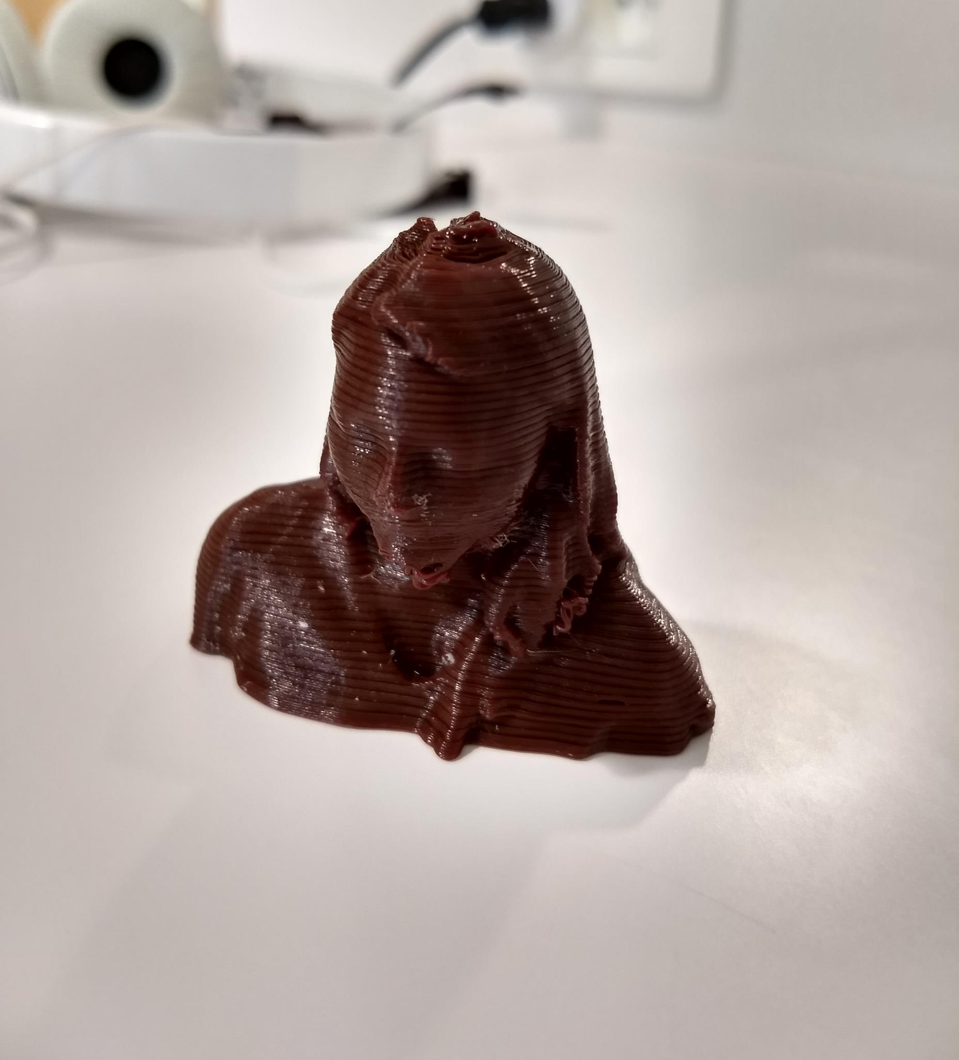
2.1. Plastics used in 3D Printing
PET: Polyethylene terephthalate
PETG: Polyethylene terephthalate glycol
HDPE: High-density polyethylene
LDPE: Low-density polyethylene
PP: Polypropylene
PS: Polystyrene
PC: Polycarbonate
ABS: Acrylonitrile butadiene styrene
PLA: Polylactic acid
PEF: Polyethylene furanoate

Slide 15
OBJECTIVES
1. 3D Printing Open – Source | 2. Plastic Recycling Pre - step | 3. Circular Economy – Local Circuit
Bibliographic research: 1.1. Additive manufacturing 1.2. Plastics used in 3D Printing | Bibliographic research: 2.1. Scientific: Methods of plastic recycling 2.2. Technique: Mechanical recycling steps in centralized circuit | Bibliographic research: 3.1. Circular Economy vision 3.2. Context: Deposit of plastic wastes in Europe, France and Nancy 3.3. How to make a local circuit emerge? Business sector Public sector Citizen sector 3.4. Indicators and tools for economical, environmental and social evaluation.

Slide 16
Objectives: Plastic recycling pre – step
Systematic literature review
Scientific
Mechanical recycling steps
Technique
Operational conditions
Equipment
Plastic recycling methods

Slide 17
2.1. Methods of plastic recycling
Plastic recycling methods
[3 – 4]
Primary recycling
Physical changes to produce a new generation of products with the same purpose as the original one
Secondary recycling
(Mechanical recycling)
Physical operations applied to transform plastic waste in feedstock for another process
Tertiary recycling
(Chemical recycling)
Polymer decomposition to their constitutive monomers or other valuable low molecular weight fragments
Quaternary recycling (Energy recovery)
Combustion process performed to produce electricity and district heating
Feasible
Feasible
Not feasible: High costs, technology required.
Not feasible: No valorization of wastes.

Slide 18
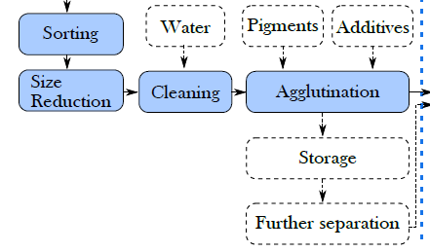
2.2. Mechanical recycling steps
Initial study of pre-step

Slide 19
2.2. Mechanical recycling steps [5]
Steps summarized as a result of literature review (40 articles studied)
Waste material
Initial sorting
Grinding
Manual sorting
Automated sorting
Washing
Second sorting
Conversion to a reusable material
Densification (films)
Extrusion compounding
Manual sorting
Automated sorting
Drying

Slide 20
2.2. Mechanical recycling steps [5]
Steps summarized as a result of literature review (40 articles studied)
Waste material
Initial sorting
Grinding
Manual sorting
Automated sorting
Washing
Second sorting
Conversion to a reusable material
Densification (films)
Extrusion compounding
Manual sorting
Automated sorting
Drying

Slide 21
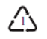
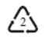


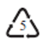
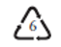

2.2. Mechanical recycling steps
Manual sorting. Plastic recycling identification symbols [5]
 | PET | Fizzy drink bottles and oven-ready meal trays
 | HDPE | Bottles for milk and washing up liquids
 | PVC | Food trays, cling film, bottles for squash, mineral water and shampoo
 | LDPE | Carrier bags and bin liners
 | PP | Margarine tubs, microwavable meal trays
 | PS | Yoghurt pots, foam meat or fish trays, hamburger boxes and egg cartons, vending cups, plastic cutlery, protective packaging for electronic goods and toys
 | OTHER | Any other plastics that do not fall into any of the above categories.

Slide 22
2.2. Mechanical recycling steps [5]
Steps summarized as a result of literature review
Waste material
Initial sorting
Grinding
Manual sorting
Automated sorting
Washing
Second sorting
Conversion to a reusable material
Densification (films)
Extrusion compounding
Manual sorting
Automated sorting
Drying

Slide 23
2.2. Mechanical recycling steps
Automated sorting techniques [6]
Technology |  | Additional substances | Equipment | Separation principle
Direct sorting | Magnetic Density Separation | Magnetic liquid (ferrofluid) | Large magnets | Difference in density
 | Tribo-electrostatic | - | Tribo-charging chamber | Difference in electrical conductivity
 | Hydro-cyclone | Water | Cyclone | Difference in density
 | Jigging | Water | Pulsatile bed (perforated vessel) | Difference in density
 | Froth flotation | Water | Vessel with agitation and air admission | Plastic hydrophobicity
 | Air separator | Compressed air | Nozzle of compressed air | Difference in density
Indirect sorting | Laser Induced Breakdown Spectroscopy (LIBS) | - | High power laser pulse (neodymium-doped yttrium aluminum garnet laser), spectral range spectrometer and a processing unit | Characteristic atomic emission lines
 | X-ray fluorescence | - | High-intensity X-ray beam, detector | Characteristic atomic emission lines
 | Spectroscopic sorting | - | Light source, sensor and processor unit | Different interactions between plastics and light

Slide 24
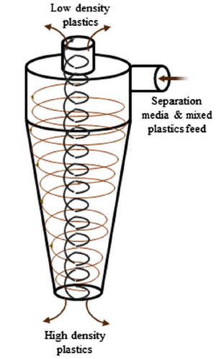
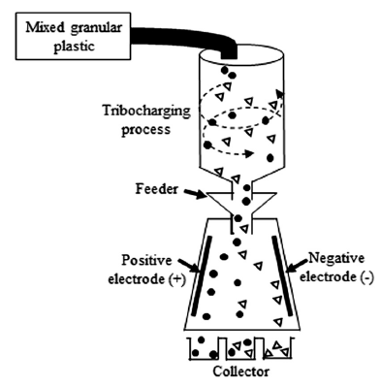
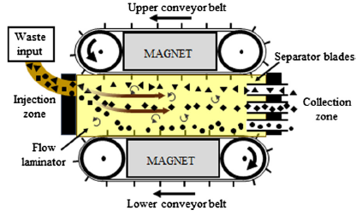
2.2. Mechanical recycling steps
Automated sorting techniques [6]
Magnetic Density Separation Tribo-electrostatic Hydro-cyclone

Slide 25
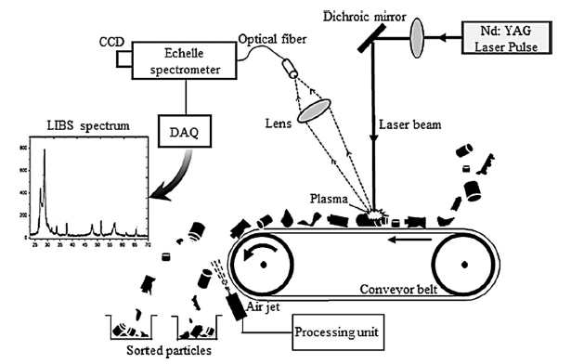
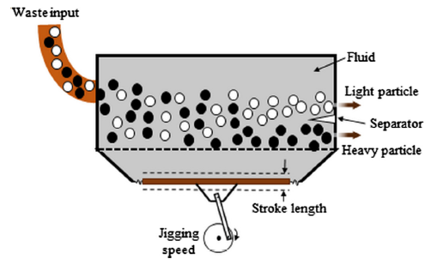
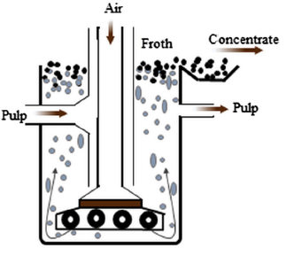
2.2. Mechanical recycling steps
Automated sorting techniques [6]
Jigging Froth flotation Laser Induced Breakdown Spectroscopy (LIBS)

Slide 26
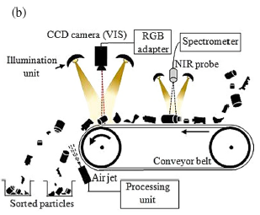
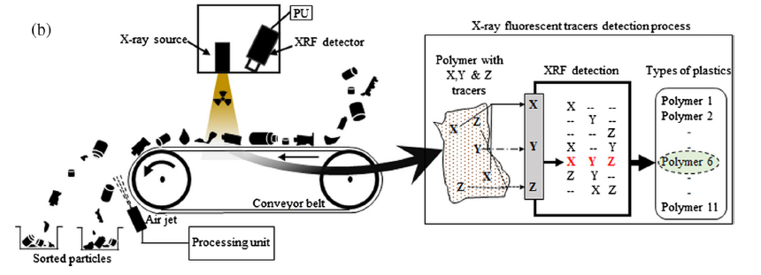
2.2. Mechanical recycling steps
Automated sorting techniques [6]
X-ray fluorescence Spectroscopic sorting

Slide 27
2.2. Mechanical recycling steps
Waste material
Initial sorting
Grinding
Manual sorting
Automated sorting
Washing
Second sorting
Conversion to a reusable material
Densification (films)
Extrusion compounding
Manual sorting
Automated sorting
Drying
Principal devices employed:
Cutting mill Retsch SM 100, 200, 300 (Most commonly used)
Disk mill
Operational conditions not specified

Slide 28
2.2. Mechanical recycling steps
Waste material
Initial sorting
Grinding
Manual sorting
Automated sorting
Washing
Second sorting
Conversion to a reusable material
Densification (films)
Extrusion compounding
Manual sorting
Automated sorting
Drying
Substance | Max. Concentration | Max. Temperature | Max. Time
Water | - | 60 °C (PP). 24 °C | 10 min
Water – Soap | - | 85 °C | 15 min
Water – NaOH | 1% p/p | 24 °C | 5 min
Water – NaClO | 9% v/v | - | 30 min

Slide 29
2.2. Mechanical recycling steps
Waste material
Initial sorting
Grinding
Manual sorting
Automated sorting
Washing
Second sorting
Conversion to a reusable material
Densification (films)
Extrusion compounding
Manual sorting
Automated sorting
Drying
Technology | Max. Temperature | Max. Time
Dehumidifier | 120 °C | 48 h
Oven | 100 °C | 24 h
Oven with vacuum | 85 °C | 2 h
Natural | Room temperature | 48 h
Centrifuge | - | -
Fluidized bed hot air | - | -

Slide 30
2.2. Mechanical recycling steps
Waste material
Initial sorting
Grinding
Manual sorting
Automated sorting
Washing
Second sorting
Conversion to a reusable material
Densification (films)
Extrusion compounding
Manual sorting
Automated sorting
Drying
Grinding, washing and drying steps are not difficult to implement in a local distributed way
Sorting is the most complex step
Economical and social evaluation in terms of Circular Economy

Slide 31
OBJECTIVES
1. 3D Printing Open – Source | 2. Plastic Recycling Pre - step | 3. Circular Economy – Local Circuit
Bibliographic research: 1.1. Additive manufacturing 1.2. Plastics used in 3D Printing | Bibliographic research: 2.1. Scientific: Methods of plastic recycling 2.2. Technique: Mechanical recycling steps in centralized circuit | Bibliographic research: 3.1. Circular Economy vision 3.2. Context: Deposit of plastic wastes in Europe, France and Nancy 3.3. How to make a local circuit emerge? Business sector Public sector Citizen sector 3.4. Indicators and tools for economical, environmental and social evaluation.

Slide 32
Intersection of objectives 1 and 2
PET: Polyethylene terephthalate
PETG: Polyethylene terephthalate glycol
HDPE: High-density polyethylene
LDPE: Low-density polyethylene
PP: Polypropylene
PS: Polystyrene
PC: Polycarbonate
ABS: Acrylonitrile butadiene styrene
PVC: Polyvinyl chloride
PLA: Polylactic acid
PEF: Polyethylene furanoate
Plastics
commonly
recycled
Plastics
3D Printing
PVC
PET
HDPE PETG
LDPE
PP PLA
PS PEF
PC
ABS

Slide 33
OBJECTIVES
1. 3D Printing Open – Source | 2. Plastic Recycling Pre - step | 3. Circular Economy – Local Circuit
Bibliographic research: 1.1. Additive manufacturing 1.2. Plastics used in 3D Printing | Bibliographic research: 2.1. Scientific: Methods of plastic recycling 2.2. Technique: Mechanical recycling steps in centralized circuit | Bibliographic research: 3.1. Circular Economy vision 3.2. Context: Deposit of plastic wastes in Europe, France and Nancy 3.3. How to make a local circuit emerge? Business sector Public sector Citizen sector 3.4. Indicators and tools for economical, environmental and social evaluation.

Slide 34
OBJECTIVES: Circular economy – Local circuit
Context: Statistics of generated, treated and recycled plastic wastes in Europe, France and Nancy
Information required:
Indicators for process evaluation
Tools for the implementation of local circuit
Case of study: Nancy
How to make a local circuit emerge?
Economical and social point of view
Business sector
Public sector
Citizen sector

Slide 35
3.1. CIRCULAR Economy vision
Circular Economy
“Industrial economy that is restorative or regenerative by intention and design”
“Economy that is restorative by design, and which aims to keep products, components and materials at their highest utility and value, at all times.”
“Realization of (a) closed loop material Flow in the whole economic system”
Ellen MacArthur Foundation (EMF), 2013b. Towards the Circular Economy, vol. 1 (Isle of Wight).
Geng, Y., Doberstein, B., 2008. Developing the circular economy in China: challenges and opportunities for achieving “leapfrog development.” Int. J. Sustain. Dev. World Ecol. 15, 231e239.
Webster, K., 2015. The Circular Economy: a Wealth of Flows. Ellen MacArthur Foundation, Isle of Wight.

Slide 36
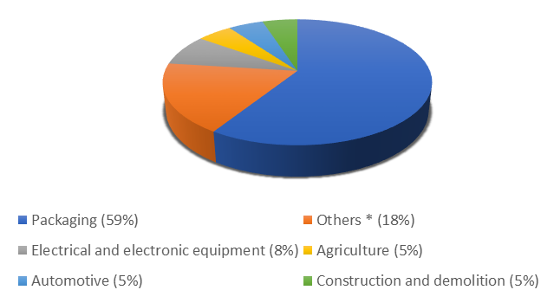
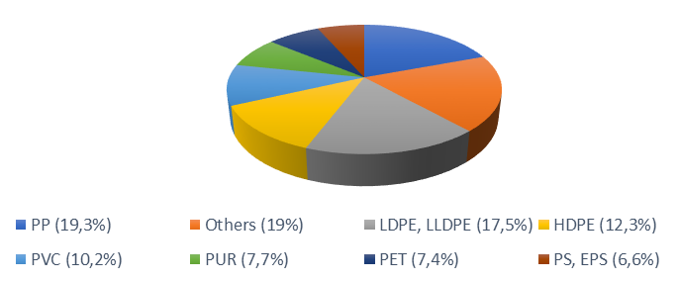
3.2. Context: Deposit of plastic wastes
Deposit of plastic wastes in Europe
Figure 2. European plastic converter demand in 2017. [7]
Figure 3. Plastic waste generation in Europe in 2015. [8]
* Consumer and household appliances, furniture, sport, health and safety

Slide 37
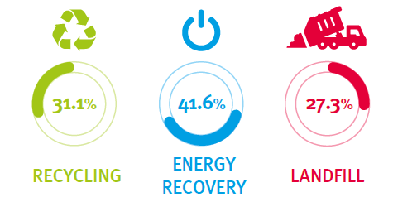
3.2. Context: Deposit of plastic wastes
Deposit of plastic wastes in Europe
Figure 5. Plastic waste treatment in 2016. [7]
Figure 4. Plastic resins content in European waste streams in 2012. [9]

Slide 38
3.2. Context: Deposit of plastic wastes
Deposit of plastic wastes in France
Figure 6. Waste treatment in France in 2016. [10]
Figure 7. Plastic flows in France in 2012. [11]

Slide 39
3.2. Context: Deposit of plastic wastes
Deposit of plastic wastes in Nancy
Figure 8. Collected tonnes in Nancy in 2017. [12]
Figure 9. Recycled tonnes in Nancy in 2017. [12]

Slide 40
Interviews: Proposal
Some key points:
PBC intention is low if the facilities seems insufficient [13] →
Publicity, promoting and explaining the recycling process is an important success factor [14] →
Public bring plastic often when they are going to buy something (on the road) [15] →
Sufficient facilities
We have to explain the project to the participants
The position of the banks in the circuit is important

Slide 41
Interviews: Proposal
Methodology: Three cases
1. With citizen public:
End of May: Creation of an event were big public can be able to bring their plastic wastes. In this place there will be:
Food sales (meals, drinks)
Spots where recycling will be recompensated (little gifts made of plastic recycled by 3D Printing)
2. With business sector:
Test in September – October for recycling inside the companies
3. With the public sector:
Test in September in high – schools

Slide 42
Interviews: Proposal
Key factors
Target publicity, especially for the lower-recycling groups in society
Enablers: infrastructure, education and information and removal of barriers
Encouragement: taxes, penalties, rewards and league tables
Engagement: communication, feedback, consultation, community involvement and bottom up policies
Exemplify: leading by example
Possible questions
User’s characterization: gender, age, place of residence, occupation
Attitude towards recycling (interested, not interested)
Habits of recycling (material: newspaper, glass, plastic, etc.)
Frequency of recycling (daily, weekly) within a fixed period of time
The extension of recycling behavior as a habit
Perception availability of recycling facilities
Place where users use plastic banks (on the way to shops, special trips, on the way to other activities, on the way to work, etc)

Slide 43
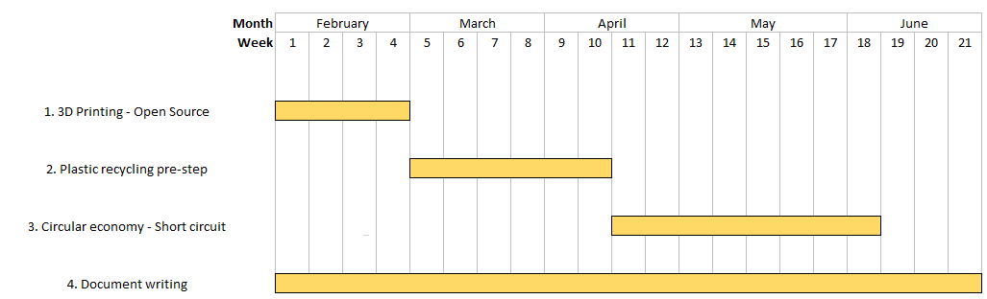
planning

Slide 44
Next steps
1. 3D Printing Open – Source | 2. Plastic Recycling Pre - step | 3. Circular Economy – Local Circuit
Bibliographic research: 1.1. Additive manufacturing 1.2. Plastics used in 3D Printing | Bibliographic research: 2.1. Scientific: Methods of plastic recycling 2.2. Technique: Mechanical recycling steps in centralized circuit | Bibliographic research: 3.1. Circular Economy vision 3.2. Context: Deposit of plastic wastes in Europe, France and Nancy 3.3. How to make a local circuit emerge? Business sector Public sector Citizen sector 3.4. Indicators and tools for economical, environmental and social evaluation.

Slide 45
References
[1] S. C. Ligon et al., “Polymers for 3D Printing and Customized Additive Manufacturing,” 2017.
[2] Hybrid Manufacturing Technologies, “7 Families of Additive Manufacturing.” [Online]. Available: http://www.hybridmanutech.com/resources.html#.
[3] M. Okan, H. M. Aydin, and M. Barsbay, “Current approaches to waste polymer utilization and minimization : a review Meltem Okan , a Halil Murat Aydin b and Murat Barsbay c * STATE AND CONVENTIONAL METHODS OF,” no. May, 2018.
[4] K. Ragaert, L. Delva, and K. Van Geem, “Mechanical and chemical recycling of solid plastic waste,” Waste Manag., vol. 69, pp. 24–58, 2017.
[5] K. Makenji, “Mechanical methods for recycling waste composites,” Manag. Recycl. Reuse Waste Compos., pp. 217–252, 2009.
[6] S. Paulraj, S. Hait, and A. Thakur, “A review on automated sorting of source-separated municipal solid waste for recycling,” Waste Manag., vol. 60, pp. 56–74, 2017.
[7] Plastics Europe, “Plastics – the Facts 2018,” 2018.
[8] European Commission, “A European strategy for plastics in a circular economy.”
[9] M. Hestin, T. Faninger, and L. Milios, “Increased EU Plastics Recycling Targets : Environmental , Economic and Social Impact Assessment Final Report Prepared for Plastic Recyclers Europe,” 2016.
[10] Eurostat, “Eurostat Database.” [Online]. Available: https://ec.europa.eu/eurostat/web/waste/data/database.
[11] Deloitte. ADEME, “Analyse de la chaîne de valeur du recyclage des plastiques en France - Synthèse,” 2014.
[12] GrandNancy, “Rapport annuel 2017,” 2017.
[13] C. Knussen, F. Yule, J. MacKenzie, and M. Wells, “An analysis of intentions to recycle household waste: The roles of past behaviour, perceived habit, and perceived lack of facilities,” J. Environ. Psychol., vol. 24, no. 2, pp. 237–246, 2004.
[14] R. E. Timlett and I. D. Williams, “Public participation and recycling performance in England: A comparison of tools for behaviour change,” Resour. Conserv. Recycl., vol. 52, no. 4, pp. 622–634, 2008.
[15] S. McDonald and R. Ball, “Public participation in plastics recycling schemes,” Resour. Conserv. Recycl., vol. 22, no. 3–4, pp. 123–141, 1998.

Slide 46
Thank you for your attention

